Slide 1
Quality inspection of garments
Name :- D.Shruthi
Roll no :- MDM18B013

Slide 2
Problem statement
In the garment industry quality control is practiced right from the initial stage of sourcing raw materials to the stage of final finished garment. For textile and apparel industry product quality is calculated in terms of quality and standard of fibres, yarns, fabric construction, colour fastness, surface designs and the final finished garment products.
The objective of the quality control is to maximize the production of goods within the specified tolerances and to achieve a satisfactory design of the fabric or garment in relation to the level of choice in design, styles, colours, suitability of components and fitness of product for the market.

Slide 3
Goals
Be able to detect errors faster.
Give accurate results.
Tools like Measurement tape, Digital camera, Defective stickers, Pantone colour
swatch, bar code scanner are used by QIT to perform measuring, take picture of
defect, mark defective areas, check colour, scan respectively.
These things should be performed by our product.
Sometimes the garments gets defective while packaging so our product should
be able to pack the garments if it finds the garment not defective and segregate
defective product into minor, major and critical.

Slide 4
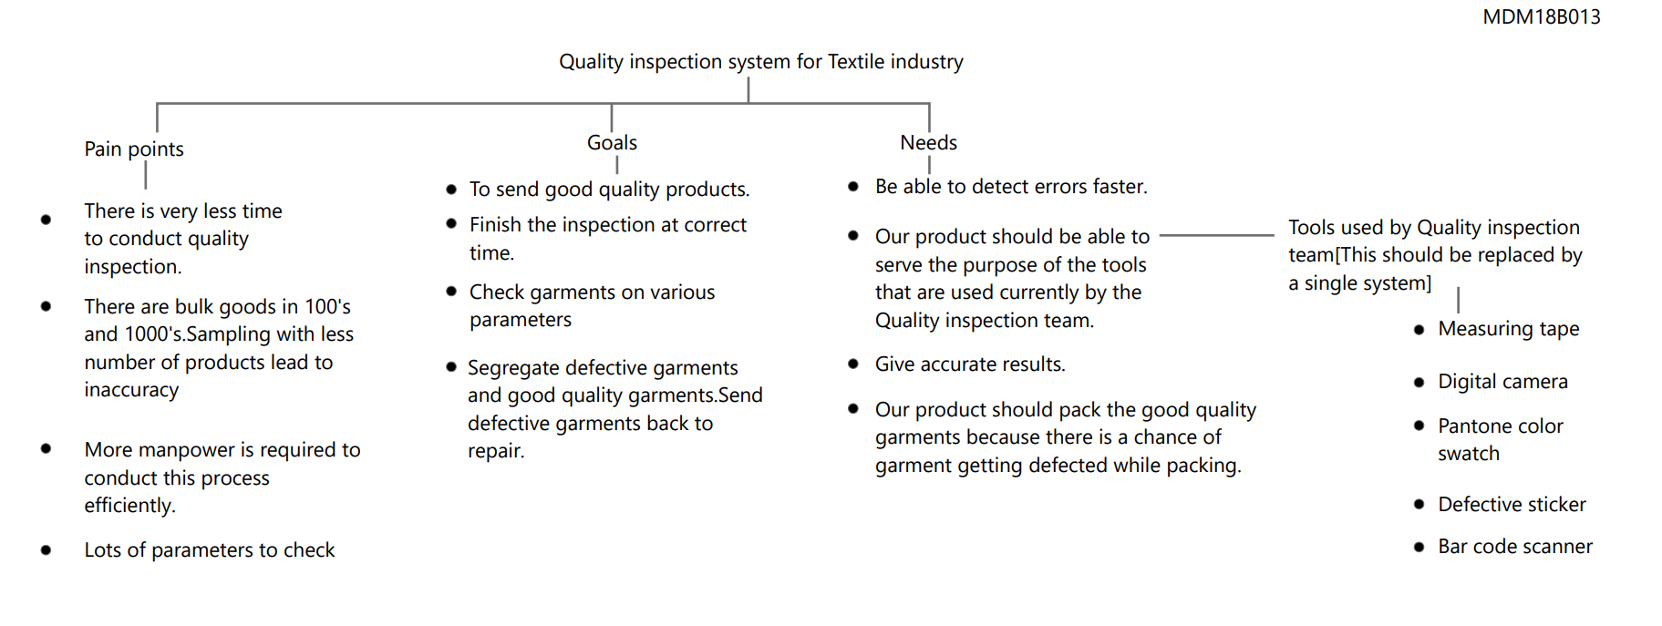
Affinity maps

Slide 5
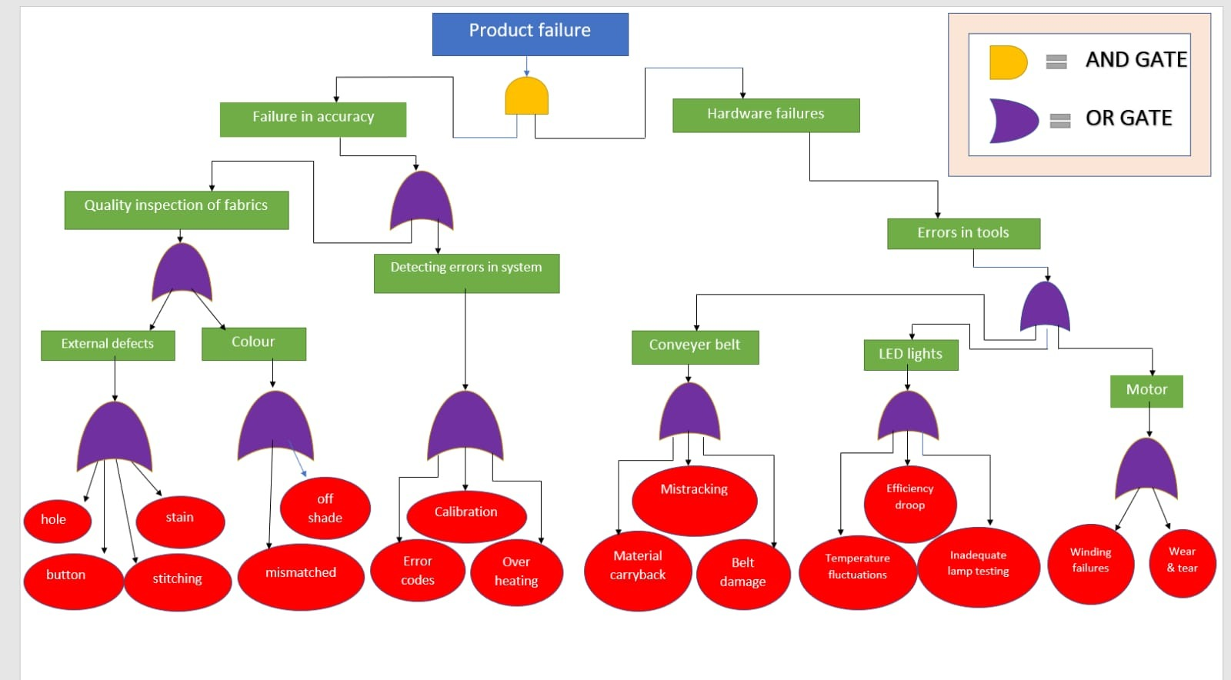
Product failures

Slide 6
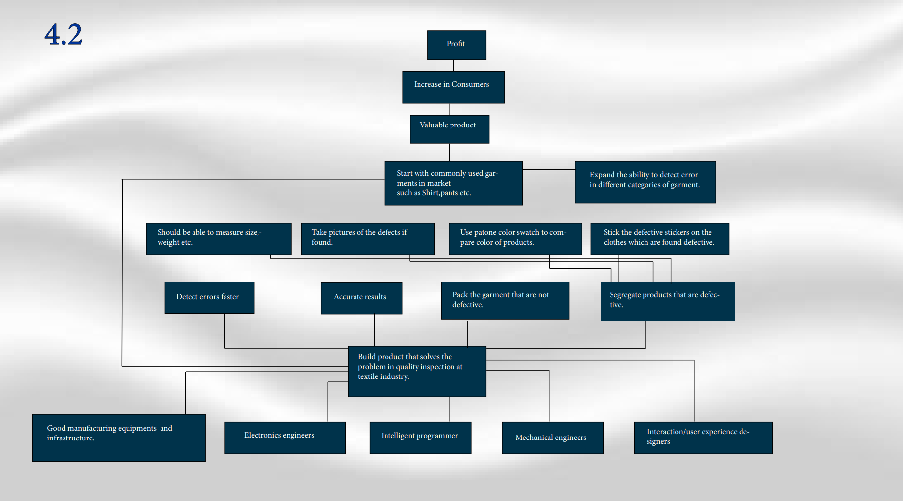
Marketing profit strategy

Slide 7
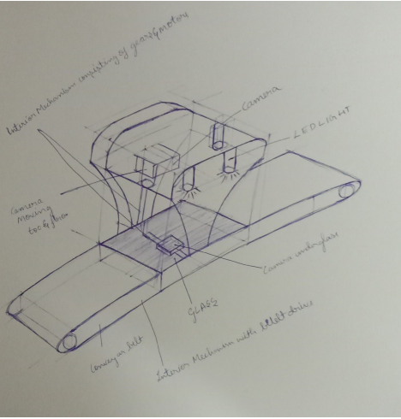
Our product sketch

Slide 8
Our future plans for research
There are wide variety of designs in garments for men and women like
Men : Shirt, Jeans, Suit, Long-sleeve top, Jeans, Suit, Shorts, Singlet, Sleeveless shirt, Cardigan, tie, Jacket, Vest, T-shirt, Polo shirt ,Underwear, Cargo pants, Swimsuit, Underpants, Waistcoat, Socks, Blazer, Sweater etc.
Women : Skirt, Dress pants, Jumper, Bikini, leggings, Sarees, Chudidhars, Salwar, Khurtha etc.
So, We plan to gather more data related to how the different garments are evaluated based on their unique attributes.
We are trying to gather more data and narrow down our research. Before next sem we are trying prepare a model

